Slide 1

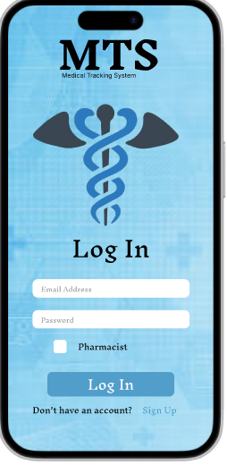

Medical Tracking System
This presentation outlines a transformative solution to address medication access challenges, particularly in remote areas. Our medication availability tracking system connects patients and pharmacists, ensuring timely access to essential medications and improving healthcare outcomes. We aim to save time and money, and reduce stress and uncertainty.

Slide 3
The Pressing Problem: Medication Scarcity and Access Barriers
Remote Access Issues
Availability Uncertainty
Many individuals face significant barriers to accessing necessary medications.
Patients often lack real-time information on medication availability.
This is primarily due to long travel distances and limited transportation.
This uncertainty leads to wasted trips and treatment delays.

Slide 4
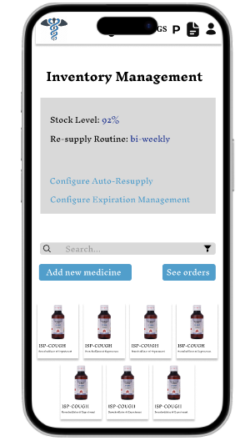
Our Innovative Solution: A Real-Time Tracking System
1
Real-Time Availability Checks
2
Pharmacist Stock Updates
Empower patients to instantly verify medication stock levels at nearby pharmacies.
Enable pharmacists to efficiently manage inventory and send alerts on medication availability.
3
Reduced Unnecessary Travel
Minimize travel time and costs for patients by providing accurate medication information.

Slide 5
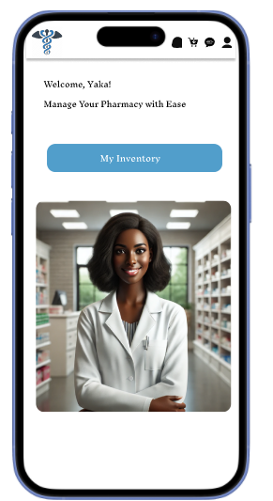

Target Users: Empowering Patients and Pharmacists
Damasene Nshuti (Patient)
Local Pharmacist
A rural resident needing chronic medication, checks availability before traveling.
Manages inventory, updates stock, and notifies customers about availability.

Slide 6




Key Desirability Factors: Time, Cost, and Peace of Mind
Saves Time
Reduces Costs
Enhances Access
Reduces travel time by ensuring medication availability beforehand.
Minimizes unnecessary travel expenses for patients.
Improves healthcare access, especially in remote locations.

Slide 7



Viability: A Sustainable Business Model
2
Subscription Model
1
Local Partnerships
Data Insights
3
Our business model relies on strategic partnerships with local pharmacies. A subscription model for premium features generates recurring revenue. We provide data insights for healthcare providers that optimize medication distribution.

Slide 8
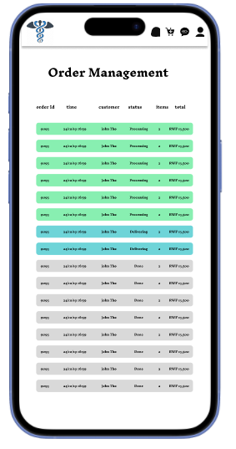



Feasibility: Streamlined Technology Requirements
Real-time Inventory Tracking
Enables pharmacists to instantly update and manage medication stock levels.
Mobile App Development
Provides a user-friendly interface for patients and pharmacists.
Pharmacy System Integration
Ensures seamless data exchange and accurate medication information.

Slide 9
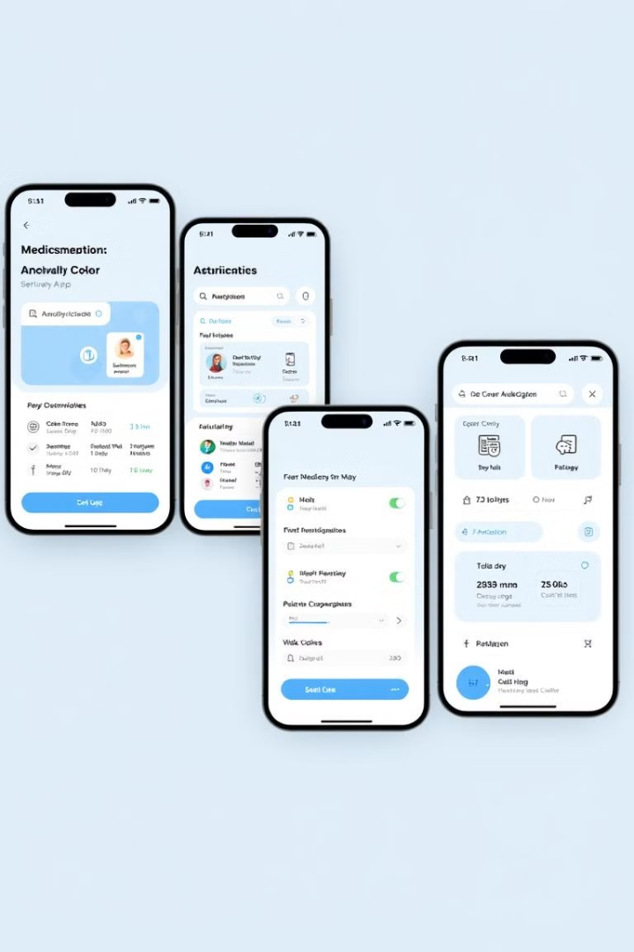
Key Features: Wireframe Highlights
Login/Register
Secure authentication for patients and pharmacists.
Profile Management
Personal information and medication list management.
Medication Search
Search by location and availability.
Booking & Notifications
Medication alerts and refill reminders.

Slide 10

Process: From Research to Deployment
Research & Definition
1
Identify and analyze user needs and pain points.
2
Wireframe & Prototype
Develop a visual representation of the system.
Integration & Testing
3
Integrate tracking and test with pharmacies.
4
Deployment & Monitoring
Deploy and monitor for improvements.

Slide 11

Key Takeaways: Transforming Medication Access
Our medication availability tracking system offers a viable solution to improve healthcare access. By connecting patients and pharmacists and using technology, we enhance medication availability. We reduce unnecessary travel, and we streamline healthcare operations. Our system holds the promise of transforming medication access and impacting public health.

Slide 12
